Slide 1
Introduction to Computer Systems
By: Iman Khani Jazani
Senior Data Scientist, Adin
Technical AI Product Manager and Advisor, Mehra
NLP Researcher, VoXera
Adjunct Professor, Sharif University of Technology

Slide 2
Last lecture
Course Information
Discussion about Programming and Python in Research and Industries
Why we use Python
How to use Python

Slide 3
Today
Review the Last Lecture
History of Computation and Computers
Component of a Computer System
Type of Programs in Computers
Algorithm: Programs Brain
Application of Programming in the Digital Age!

Slide 4
Together
Send your feedback about the class whenever you want!

Slide 5
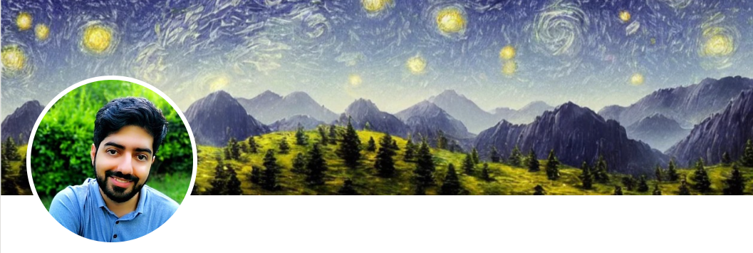
Contact me
Gmail: ImanKhaniJazani@gmail.com
LinkedIn: https://www.linkedin.com/in/ImanKhaniJazani/
Telegram: @IKJ1992

Slide 6

Main links for our class
Telegram group: t.me/SharifPythonSpace1401
GitHub organization: github.com/SharifPythonSpace

Slide 7
Review the Last Lecture

Slide 8
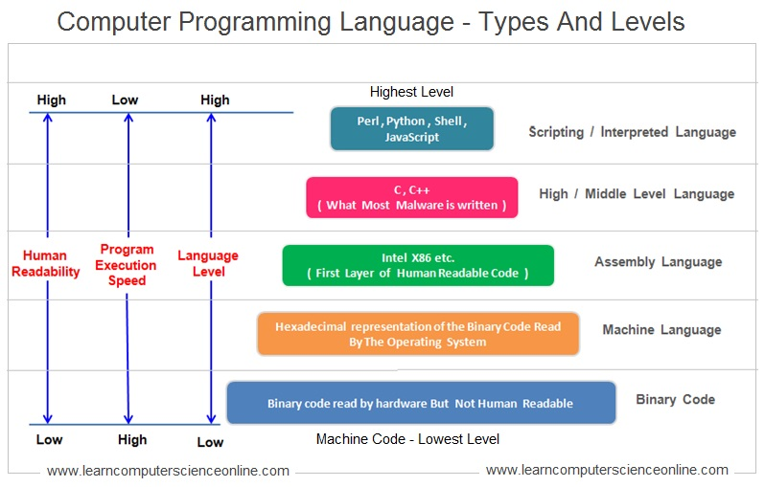
Language!

Slide 9
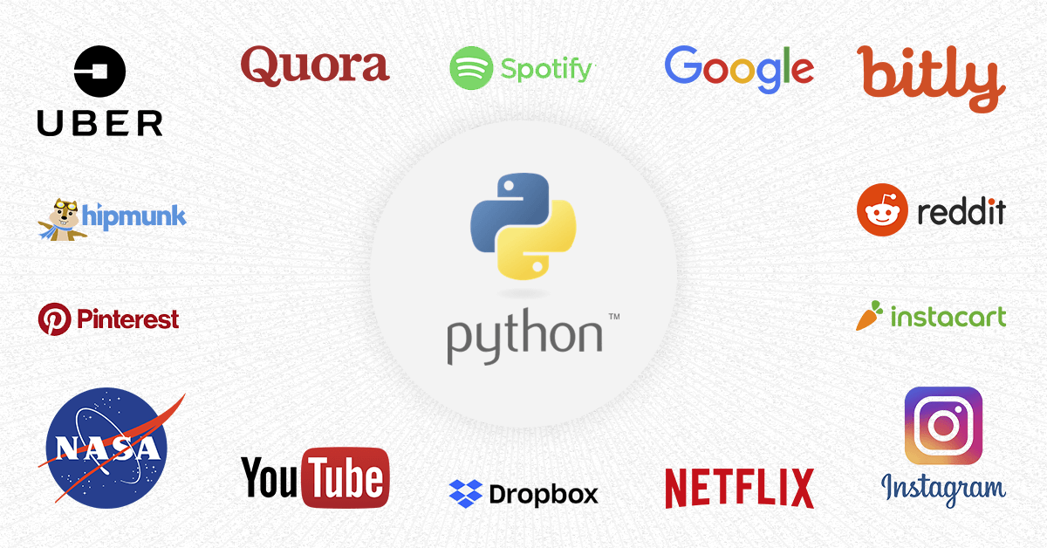
Do you know about its applications?

Slide 10
History of Computation and Computers

Slide 11
From computing…
The history of computing is longer than the history of computing hardware and modern computing technology and includes the history of methods intended for pen and paper or for chalk and slate, with or without the aid of tables.

Slide 12

From computing…
Eventually, the concept of numbers became concrete and familiar enough for counting to arise, at times with sing-song mnemonics to teach sequences to others. All known human languages, except the Piraha language, have words for at least "one" and "two", and even some animals like the blackbird can distinguish a surprising number of items

Slide 13
From computing…
The first aids to computation were purely mechanical devices which required the operator to set up the initial values of an elementary arithmetic operation, then manipulate the device to obtain the result.

Slide 14
Timeline
1600
Mechanical Calculators
1700
Difference Engine
1800
Hollerith Tabulating Machine
Pascaline
Jacquard Loom
Analytical Engine
Punched Card Tabulating Machines
Teletype
Vacuum Tube
1900
Transistor
Integrated Circuit
Microprocessor
Personal Computer
2000
Cloud Computing
Tablets
Smartphones
Internet of Things (IoT)
3000

Slide 15
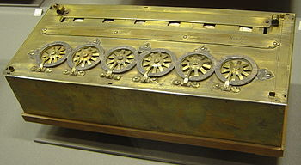
Pascaline
چرا اختراع شد؟!

Slide 16
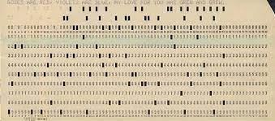
Punched card
اگه بخوایم ویرایش کنیم چی؟!

Slide 17

Punch card machine

Slide 18
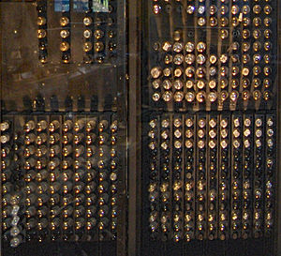
Vacuum tube computers
17000 لامپ خلا

Slide 19
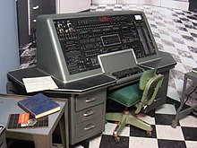
UNIVAC (UNIVersal Automatic Computer)

Slide 20
Course plan
Fundamental concepts in computer science
Algorithm thinking
Coding with Python
Some meetings with Python experts in different domains (maybe)

Slide 21
Be in path
Programming Language
Knowledge of Concepts
Algorithm Thinking

Slide 22
TAs plan
Python workshop abut AI and DS
Python Coding class for assignments
Python Event for CE department (maybe)
Useful Python toolkits in industry:
Git, GitHub
Docker
FastAPI
Dask
…

Slide 23
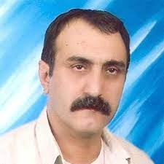
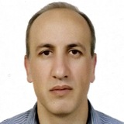
MANY Thanks to…
Dr. Abbas Nowzari
Associate Professor, Tehran University
Dr. Mohammad Ganjtabesh
Associate Professor, Tehran University

Slide 24
Discussion about Python in Research and Industries

Slide 25
What is programming?

Slide 26
What is Python?

Slide 27
Do you know about its applications?

Slide 28
Why we use Python?

Slide 29
Language!

Slide 30
How to use Python?

Slide 31
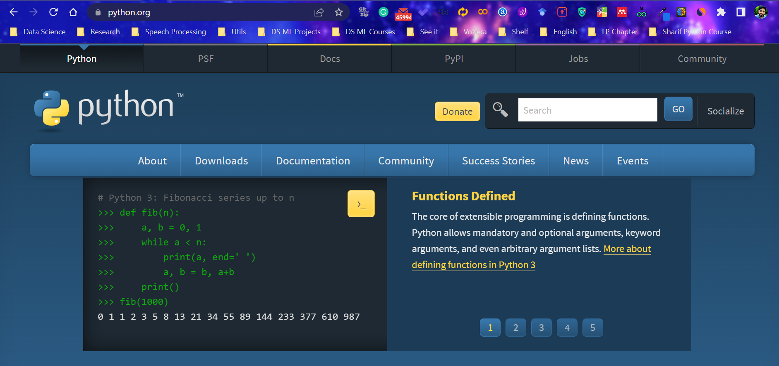
First, install Python

Slide 32
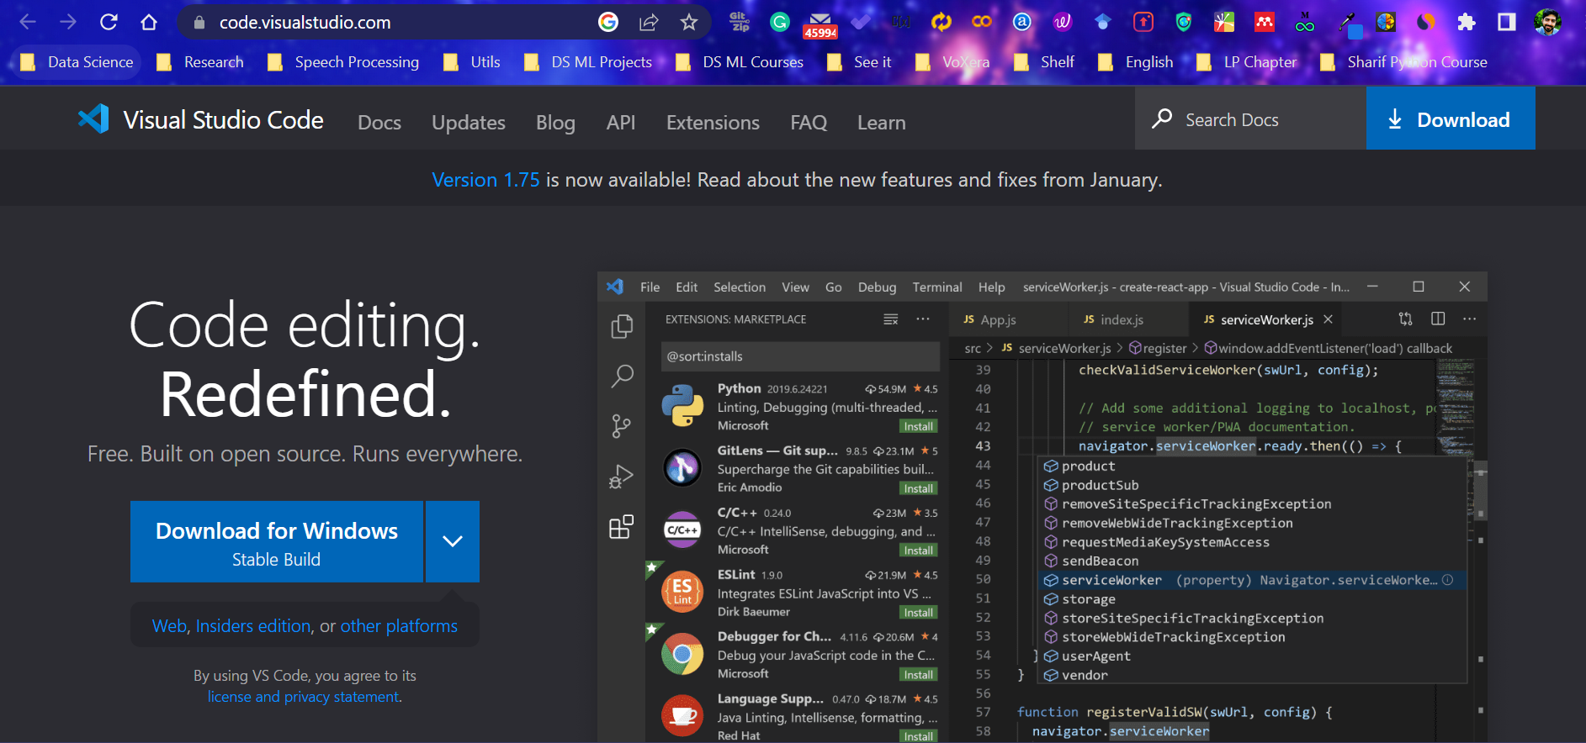
Second, install visual studio code (vscode)

Slide 33
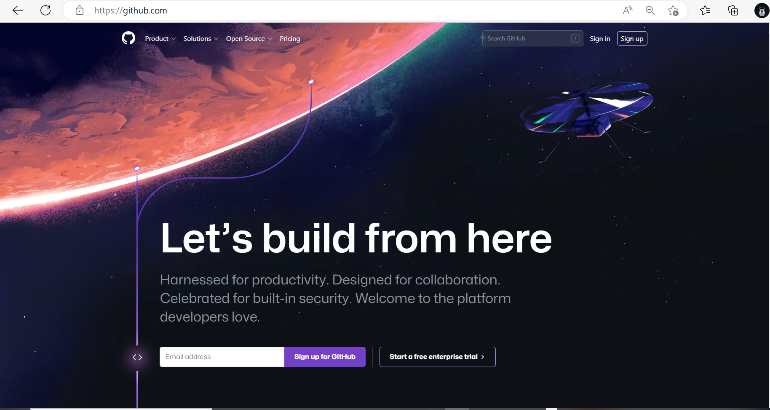
Third, register in GitHub

Slide 34
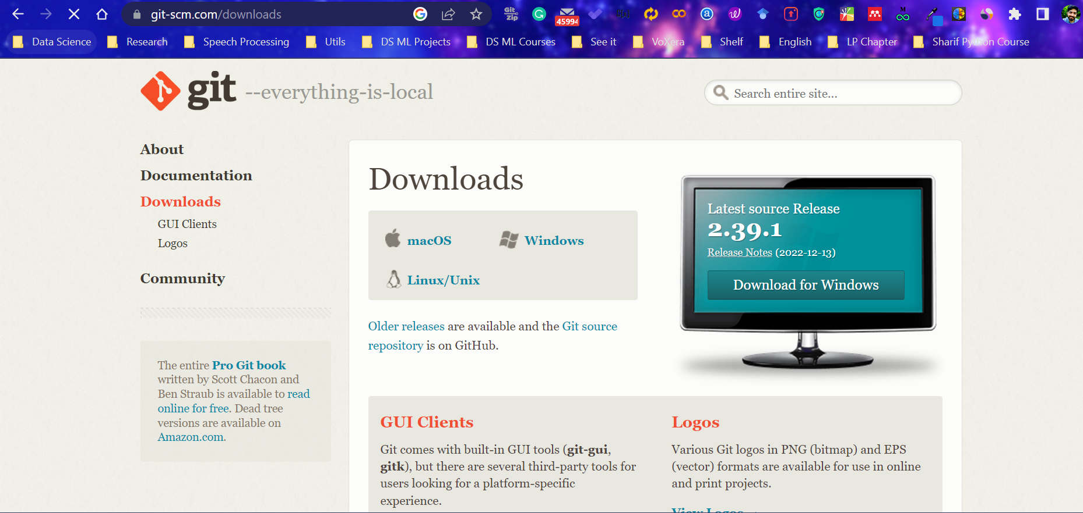
Fourth, install Git

Slide 35
Lecture Resources
P. Wentworth, J. Elkner, A. B. Downey, C. Meyers. How to Think Like a Computer Scientist: Learning with Python. 3rd Edition, Open Book Project, 2011.
https://en.wikipedia.org/wiki/History_of_computing
https://en.wikipedia.org/wiki/History_of_computing_hardware

